Slide 1
Digital Portfolio
STUDENT NAME: MANOJ SHANKAR M
REGISTER NO AND NMID: 222404361 5AF86941355E9AC9E1C4D2BAA
DEPARTMENT: BSC COMPUTER SCIENCE
COLLEGE: COLLEGE/ UNIVERSITY AGURCHAND MANMULL JAIN COLLEGE/UNIVERSITY OF MADRAS

Slide 2
PROJECT TITLE
HTML LABELS

Slide 3


AGENDA
Problem Statement
Project Overview
End Users
Tools and Technologies
Portfolio design and Layout
Features and Functionality
Results and Screenshots
Conclusion
Github Link
3/21/2024 Annual Review

Slide 4

PROBLEM STATEMENT
User experience — Users may get confused while filling out forms.
Accessibility — Screen readers cannot correctly interpret unlabeled inputs.
Form validation — Users may enter incorrect data if fields are unclear.

Slide 5

PROJECT OVERVIEW
This project focuses on using the HTML <label> element to create more accessible and user-friendly web forms. The <label> tag links text descriptions to input fields, helping users understand what information is required and improving navigation. Proper use of labels enhances the overall usability, supports screen readers, and ensures a better experience for all users while filling out forms.

Slide 6

WHO ARE THE END USERS?
The end users are individuals who interact with web forms on websites or applications. They can include:
1. General Users – People filling out forms for registrations, logins, feedback, or purchases.
2. Visually Impaired Users – Users who rely on screen readers benefit from properly implemented <label> elements.
3. Elderly Users – Clear labels make forms easier to understand and navigate.
4. Mobile Users – Labels improve touch accessibility by making input selection easier.

Slide 7

TOOLS AND TECHNIQUES
Tools and Techniques of HTML Labels (Simple Version):
Tools: Text editor (like Notepad, VS Code), Web browser (Chrome, Firefox).
Techniques: Use <label> tag, connect it with form elements using for attribute, place label text near input fields for clarity.

Slide 8
POTFOLIO DESIGN AND LAYOUT
!DOCTYPE html>
<html>
<head>
<title>HTML Label Example</title>
</head>
<body>
<h2>Registration Form</h2>
<form>
<label for="name">Name:</label>
<input type="text" id="name" name="name"><br><br>
<label for="email">Email:</label>
<input type="email" id="email" name="email"><br><br>
<label for="password">Password:</label>
<input type="password" id="password" name="password"><br><br>
<input type="submit" value="Submit">
</form>
</body>
</html>
M
8

Slide 9
FEATURES AND FUNCTIONALITY
Used with input boxes, checkboxes, etc.
Makes text clickable.
Connects text to input.
Function
Clicking label selects or focuses the input.

Slide 10
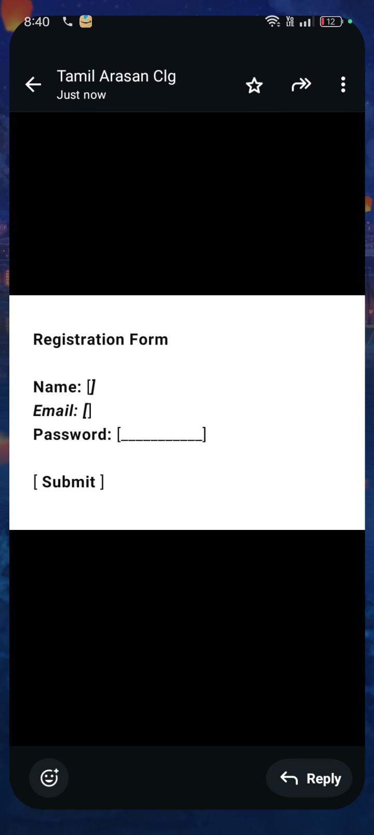
RESULTS AND SCREENSHOTS
Result:
The HTML program successfully displays a simple registration form with properly associated <label> elements.
3/21/2024 Annual Review
10

Slide 11
CONCLUSION
Simple Conclusion:
HTML labels help users know what to enter in forms. They make forms easier to use and help everyone, including people using screen readers.

